Slide 1
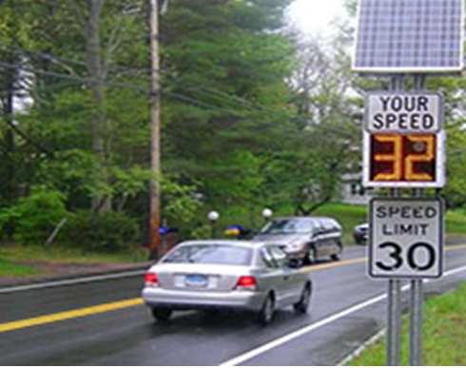

A Novel Evolving Classifier with a False Alarm Class for Speed Limit Sign Recognition
IEEE Congress on Evolutionary Computation 2021
Authors:
Pubudu Sanjeewani (Presenting Author)
Brijesh Verma
Joseph Affum
Source: Google Images

Slide 2
Introduction
The main purpose is to develop an Australian Road Assessment Program (AusRAP) attribute detection system.
The goal of AusRAP attribute detection system is to detect and identify all road attributes to assess road safety.
The major problem is the misclassification of many attributes with text.
Automatic interpretation of information written on roadside signs is very useful.
We propose a novel technique for automatic detection and recognition of speed limit signs.

Slide 3
What is Proposed ?
We propose a,
a Fully Convolutional Network (FCN) with all signs into one class to segment sign pixels into Region of Interests (RoIs) for accurately identifying speed signs in our AusRAP safety attribute detection,
a novel evolving classifier with a false alarm class that classifies detected pixels into individual signs or non-signs, and
large number of experiments and comparative analysis have been conducted on real-world roadside video data which have been obtained from our industry partners.

Slide 4
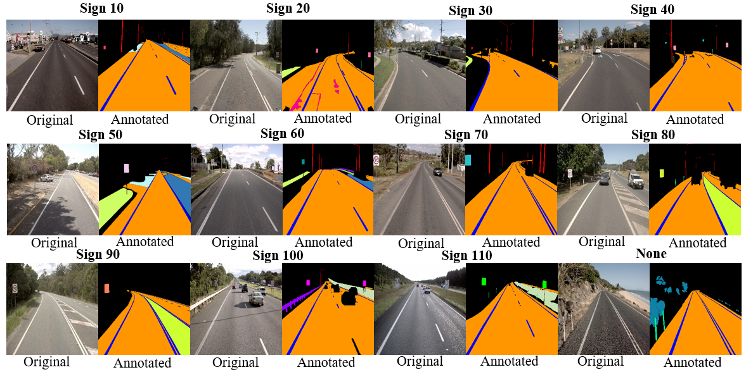
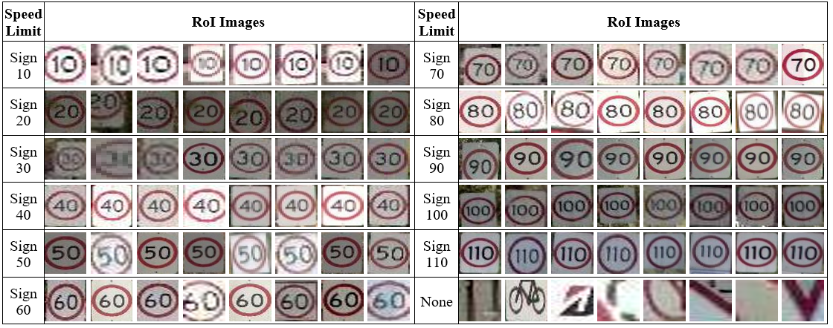
Data Preparation
Fig. 1: RoI Images Input to Evolved Classifier
Fig. 2: Speed Sign Frames and Corresponding Annotations

Slide 5
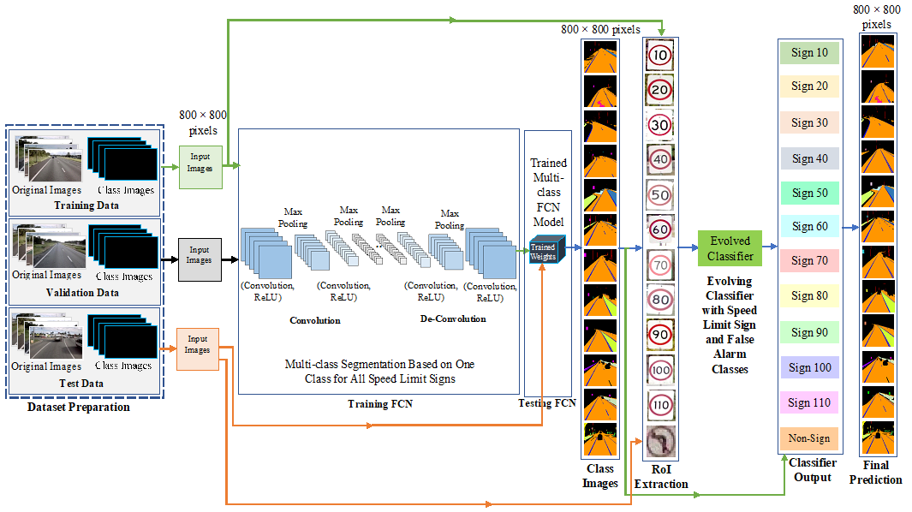
Proposed Technique
Fig. 3: Proposed Technique

Slide 6
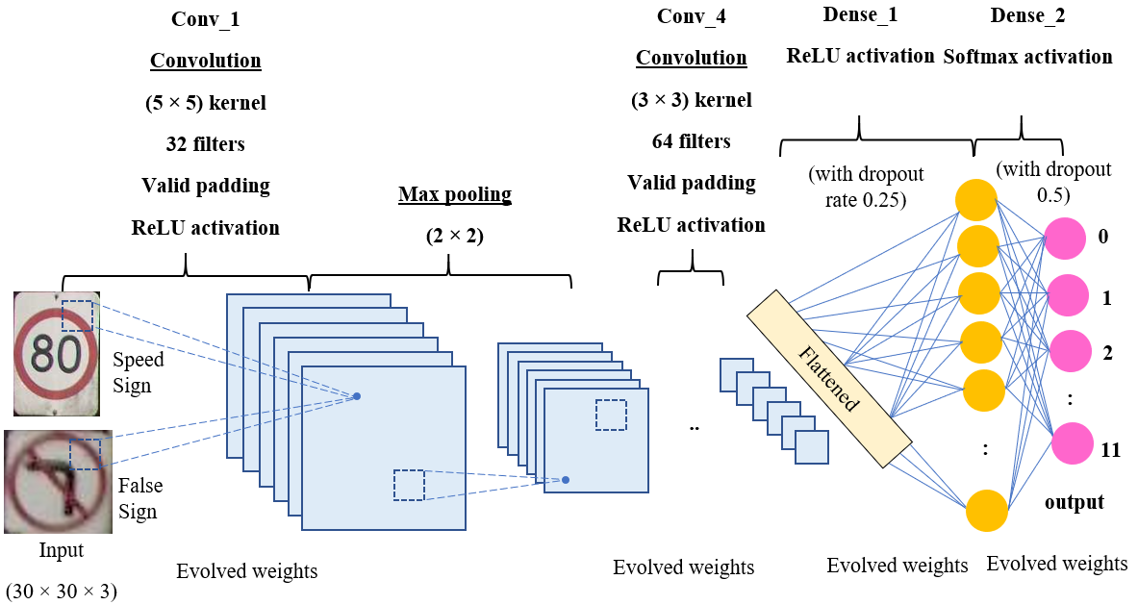
Architecture of the Proposed Classifier
Fig. 4: Architecture of the Proposed Classifier

Slide 7
Evolutionary Process for Classifier Training
Step 1: Pre-processing and resizing of detected RoIs into 30×30 images and creating a vector for 12 classes.
Step 2: Setting initial parameters including population (set of individuals), generation and epochs.
Step 3: Initializing population with different values of random weights for the classifier.
Step 4: Calculating the fitness of each individual in the population based on accuracy on validation set.
Step 5: Selecting the number of individuals from the population based on fitness.
Step 6: Performing the crossover and mutation of 6-layer weights to form better classifier weights.
Step 7: Repeating steps 4-6 until number of generations are reached.

Slide 8
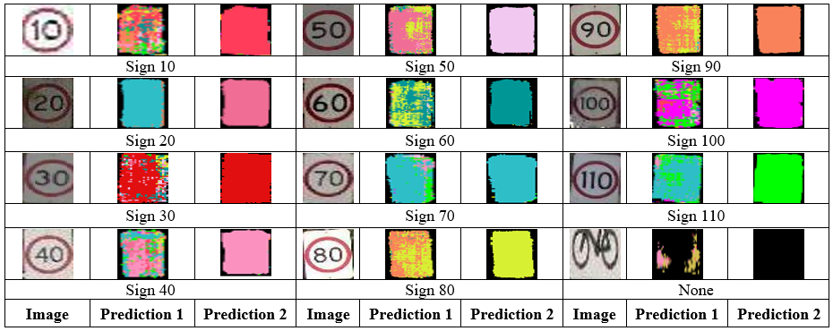
Visual Results
Fig. 5: Sample Prediction Results Obtained by the Proposed Technique With (Prediction 2) and Without (Prediction 1) Our Novel Classifier with a False Alarm Class

Slide 9
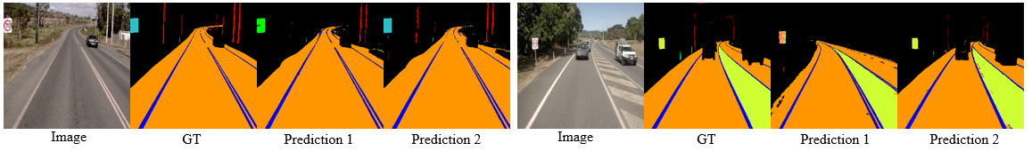
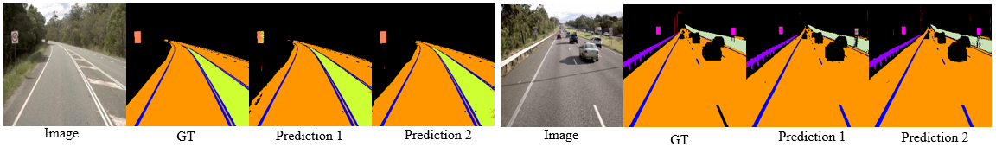
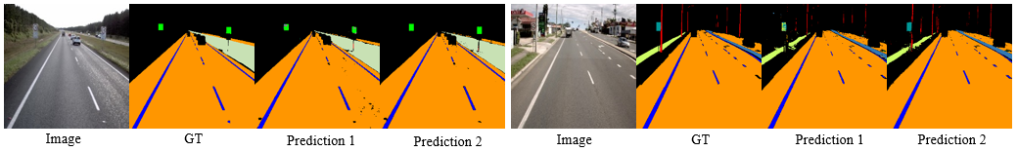
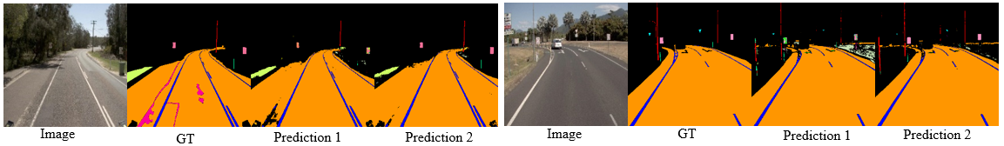
Continued..
Fig. 6: Prediction Results of Sign 70 (First Set) and Sign 80 (Second Set) Obtained by the Proposed Technique at 115,000 Iterations
Prediction 1: Without Classifier
Prediction 2: With Classifier
Fig 7: Prediction Results of Sign 90 (First Set) and Sign 100 (Second Set) Obtained by the Proposed Technique at 115,000 Iterations
Fig. 8: Prediction Results of Sign 110 (First Set) and Sign 60 (Second Set) Obtained by the Proposed Technique at 115,000 Iterations
Fig. 9: Prediction Results of Sign 20 (First Set) and Sign 40 (Second Set) Obtained by the Proposed Technique at 115,000 Iterations

Slide 10
Numeric Results
Best Accuracy and Misclassifications Obtained by the FCN Classification Technique
Best Accuracy and Misclassifications Obtained by the OCR Classifier Based Technique
Speed Limit | Accuracy (%) |  | Misclassifications (%)
 | Attribute Wise | Pixel Wise
Sign 10 | 50.00 | 48.00 | 0.94
Sign 20 | 33.34 | 13.00 | 1.89
Sign 30 | 0.00 | 0.00 | 0.94
Sign 40 | 33.34 | 28.00 | 0.94
Sign 50 | 0.00 | 0.00 | -
Sign 60 | 66.69 | 36.00 | -
Sign 70 | 14.29 | 12.00 | -
Sign 80 | 100.00 | 76.00 | 0.00
Sign 90 | 50.00 | 50.97 | 0.94
Sign 100 | 75.00 | 46.00 | 0.94
Sign 110 | 50.00 | 36.00 | -
Speed Limit | Attribute Wise Accuracy (%) | Misclassifications (%)
Sign 10 | 50.00 | 0.00
Sign 20 | 100.00 | 0.00
Sign 30 | 0.00 | 0.00
Sign 40 | 33.33 | 0.00
Sign 50 | 100.00 | 0.00
Sign 60 | 16.67 | 2.17
Sign 70 | 85.71 | 0.00
Sign 80 | 0.00 | 0.00
Sign 90 | 0.00 | 0.00
Sign 100 | 50.00 | 0.00
Sign 110 | 75.00 | 2.17
Best Accuracy and Misclassifications Obtained by the Proposed Technique
Speed Limit | Accuracy (%) | Misclassifications (%)
Sign 10 | 50.00 | 0.027
Sign 20 | 100.00 | 0.00
Sign 30 | 100.00 | 0.00
Sign 40 | 100.00 | 0.00
Sign 50 | 100.00 | 0.00
Sign 60 | 100.00 | 0.00
Sign 70 | 85.71 | 0.027
Sign 80 | 100.00 | 0.00
Sign 90 | 100.00 | 0.00
Sign 100 | 100.00 | 0.00
Sign 110 | 100.00 | 0.00
Non-signs (False alarm) | 100.00 | 0.00

Slide 11
Comparative Analysis
Speed Limit | Attribute Wise Accuracy (%)
 | Proposed Technique | Proposed Technique with OCR | Proposed Technique with FCN
Sign 10 | 50.00 | 50.00 | 50.00
Sign 20 | 100.00 | 100.00 | 33.34
Sign 30 | 100.00 | 0.00 | 0.00
Sign 40 | 100.00 | 33.33 | 33.34
Sign 50 | 100.00 | 100.00 | 0.00
Sign 60 | 100.00 | 16.67 | 66.69
Sign 70 | 85.71 | 85.71 | 14.29
Sign 80 | 100.00 | 0.00 | 100.00
Sign 90 | 100.00 | 0.00 | 50.00
Sign 100 | 100.00 | 50.00 | 75.00
Sign 110 | 100.00 | 75.00 | 50.00
False alarms | 100.00 | NA | NA

Slide 12
Conclusion and Future Work
A novel technique for detection and classification of speed limit signs is presented.
The technique has been implemented and evaluated on a large real-world dataset from industry.
Comparative analysis shows that the proposed technique produces the best classification accuracy and minimum misclassifications compared to OCR based classifier, CNN and FCN with majority pixel-based classifier
False alarm reduced to zero.
The overall accuracy achieved by the proposed technique is 95.45% which is much higher than accuracy obtained by other existing techniques.
In our future work, we will evaluate the proposed technique on all state roads in Queensland and, we will extend it to recognize other AusRAP attributes which are very similar in shape, size and color.

Slide 13

Source: Google Images

Slide 14

Source: Google Images

Slide 15
Supplementary Slides

Slide 16
Evolutionary Algorithms and Architectural Parameters for the Proposed Classifier
Evolving Parameters (Min/Max Values in Our Experiments) | Input and Output Parameters | Number of Evolving Layers | Number of Other Layers
Number of generations: min 5 and max 200 | Input size 30×30×3 (resized detected RoI) | Conv2D (32, kernel size = (5, 5), activation = ReLU) | MaxPooling2D (pool size = (2,2)
Number of individuals: min 10 and max 100 |  | Conv2D (filters = 32, kernel size = (5,5), activation = ReLU) | Dropout (0.25)
Number of epochs: min 1 and max 50 |  | Conv2D (filters = 64, kernel size = (3, 3), activation = ReLU) | MaxPooling2D (pool size = (2,2)
Mutate factor: 0.05 | Output size 12 (11 for speed signs and 1 for false alarms) | Conv2D (filters = 64, kernel size = (3, 3), activation = ReLU) | Dropout (rate=0.25)
 |  | Dense (256, activation = ReLU) | Flatten ()
 |  | Dense (12, activation = Softmax) | Dropout (0.5)

Slide 17
Sample of Generations
Generation 1:
[2.4199, 2.4533, 2.4495, 2.4574, 2.4538, 2.4502, 2.4277, 2.424, 2.435, 2.4544]
20/20 [==============================] - 1s 56ms/step - loss: 2.3263 - accuracy: 0.1571 - val_loss: 2.1675 - val_accuracy: 0.3758
20/20 [==============================] - 1s 58ms/step - loss: 1.7056 - accuracy: 0.4503 - val_loss: 0.7705 - val_accuracy: 0.8153
20/20 [==============================] - 1s 58ms/step - loss: 1.7444 - accuracy: 0.4343 - val_loss: 0.7938 - val_accuracy: 0.7580
Generation 2:
[2.3263, 2.3223, 2.3751, 2.2884, 2.1214, 2.4202, 1.2107, 1.7056, 2.3321, 1.7444]
20/20 [==============================] - 1s 58ms/step - loss: 0.5806 - accuracy: 0.8189 - val_loss: 0.2290 - val_accuracy: 0.9490
20/20 [==============================] - 1s 60ms/step - loss: 0.3196 - accuracy: 0.9103 - val_loss: 0.1444 - val_accuracy: 0.9809
Generation 3:
[0.5806, 0.7859, 0.4164, 0.2897, 0.3235, 0.8239, 0.2353, 0.1665, 0.4943, 0.3196]
20/20 [==============================] - 1s 57ms/step - loss: 0.1615 - accuracy: 0.9599 - val_loss: 0.1511 - val_accuracy: 0.9618

